Slide 1
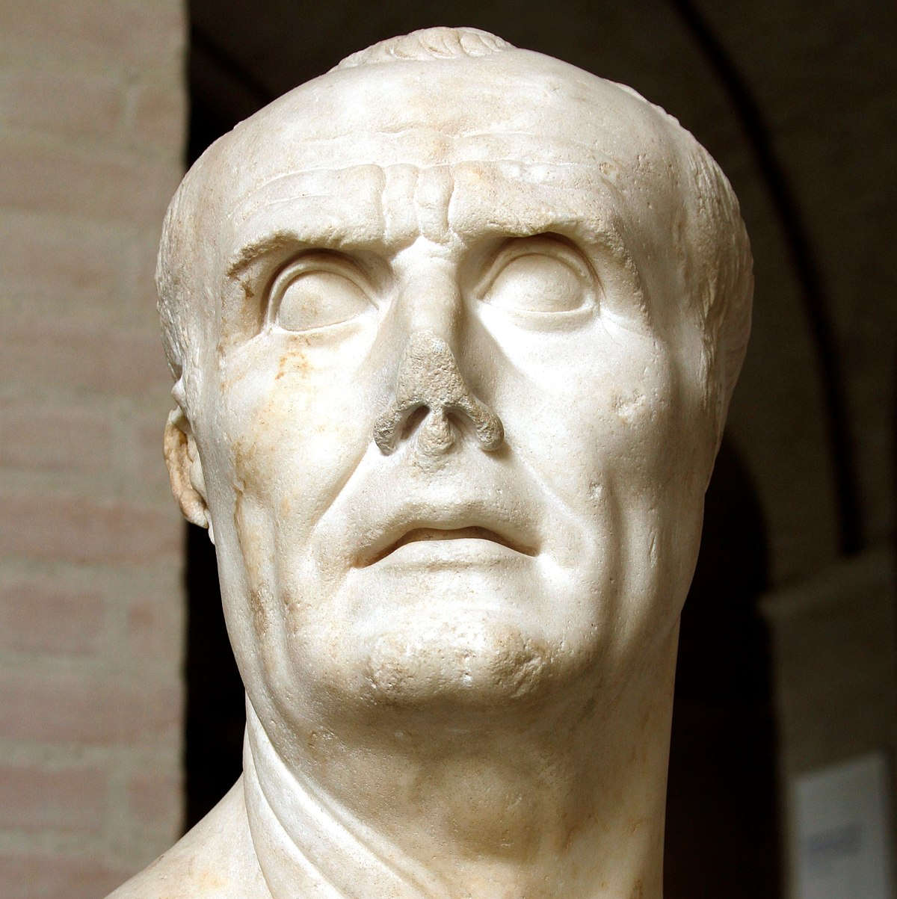
Gaius Marius
GOAL/S: Describe the life and career of Gaius Marius
Week 7, Lesson 1

Slide 2
REVIEW – Where are we up to?
Term/Week | Topic/Content | Assessments
T1 - 1 | Roman Society Overview
T1 - 2 - 3 | Roman Soc/Pol/Eco/Religion/Cul
T1 – 4 - 6 | Tiberius and Gaius Gracchus (133 – 121 BCE) | Essay (Week 6 – 10%)
T1 – 7 - 9 | Gaius Marius (133 – 87 BCE) | Source Analysis (Week 9 – 10%)
T2 – 1 - 3 | Sulla (90 – 78 BCE)
T2 – 4 – 5 | EST | EST (Week 4 – 5 – 15%)
T2 – 5 - 6 | Pompey to 66 BCE | Historical Inquiry (Week 5 – 6 – 10%)
T2 - 7 | EXAMS

Slide 3
Gaius Marius was one of the most influential and significant figures in Roman history. His life and career were full of drama and adventure, and he left a lasting legacy on the Roman world.

Slide 4
Early Life
BORN: Arpinum, a small town in Latium, in 157 BCE.
FATHER: a landowner of modest means
MOTHER: came from a wealthy family.
STATUS: equestrian - wealthy aristocrats / well known
At 17 his father died - inherited the family estate.
While he may have been influential in his hometown, Marius was unknown in Rome and when he sought to begin a career in Roman politics, he was considered a novus homo, which means 'new man'.
This meant that he was the first member of his family to serve in the Roman Senate.
Marius married into a wealthy family, which helped him advance his political career.

Slide 5
Early Career
134 BCE: served as a military officer at Numantia in Spain under the famous general Scipio Aemilianus.
valuable military experience
first step in establishing a name for himself
several failed attempts at election to different political positions in Rome before he had a sufficient reputation to enter the political arena
Marius formed a powerful political alliance with the influential Metelli family, who provided him with the extra money and important social connections he needed to advance his career further.
119BCE: elected to the position of Tribune of the Plebs
This was the beginning of a rapid series of political appoints for Marius
failed to be elected to the position of aedile in 117 BCE
115BCE: Successfully became praetor
114 BCE: Propraetor in the lucrative province of hispania ulterior in Spain.
113 BCE: Returned home with significant amount of wealth and respect.

Slide 6
ACTIVITY
The jugurthine war

Slide 7
Much to Metellus' surprise and frustration, Marius was successful in become one of the two consuls for the year 107 BCE. By this stage, Marius was popular with the people, and the Assembly voted for Marius to take command of the Jugurthine War instead of Metellus.

Slide 8
ACTIVITY - Diagram
Marius’ First Consulship
Internal Unrest
Pol/Soc Context
Reasons for Consulship
Effects of Roman Politics

Slide 9
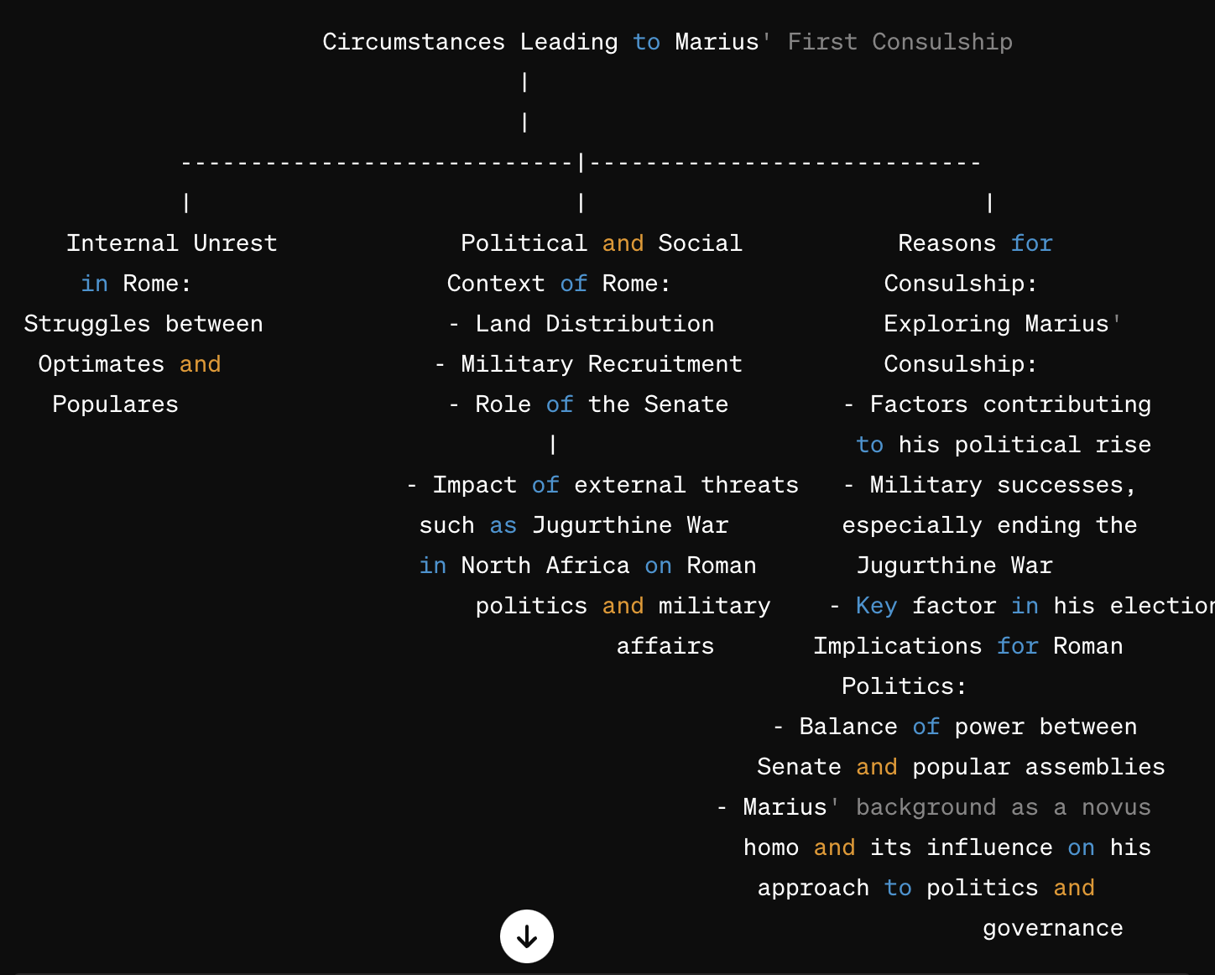

Slide 10

SUMMARY
Describe Gaius Marius in 10 separate words.
EXTENSION: https://www.youtube.com/watch?v=UIRS_PMeVVY&ab_channel=KingsandGenerals

